Slide 1


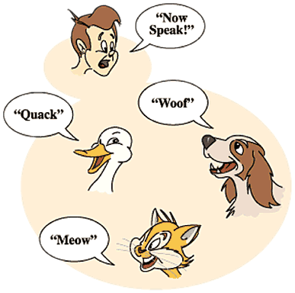

Polymorphism
Abstract Classes and Methods, Overriding
Java OOP
Basics
SoftUni Team
Technical Trainers
Software University
http://softuni.bg

Slide 2

Table of Contents
What is Polymorphism?
Types of Polymorphism
Override Methods
Overload Methods
Abstract Classes
Abstract Methods
1
Notes:
*
(c) 2007 National Academy for Software Development - http://academy.devbg.org. All rights reserved. Unauthorized copying or re-distribution is strictly prohibited.*
<number>##

Slide 3
Questions
sli.do #java-fund
2

Slide 4

Polymorphism
<number>
Notes:
© Software University Foundation – http://softuni.org
This work is licensed under the Creative Commons Attribution-NonCommercial-ShareAlike license.
<number>

Slide 5
What is Polimorphism?
From the Greek
Polus
(many)
Morphe
(shape/forms)
Polumorphos
This is something similar to word having several different meanings depending on the context
<number>
Notes:
Polymorphism is the ability of an object to take on many forms. The most common use of polymorphism in OOP occurs when a parent class reference is used to refer to a child class object.
© Software University Foundation – http://softuni.org
This work is licensed under the Creative Commons Attribution-NonCommercial-ShareAlike license.
<number>

Slide 6
Polymorphism in OOP
Ability of an object to take on many forms
public interface Animal {}
public abstract class Mammal {}
public class Person extends Mammal implements Animal {}
Person IS-A Person
Person IS-AN Animal
Person IS-A Mammal
Person IS-AN Object
<number>

Slide 7
Reference Type and Object Type
public class Person extends Mammal implements Animal {}
Animal person = new Person();
Mammal personOne = new Person();
Person personTwo = new Person();
Reference Type
Object Type
Variables are saved in reference type
You can use only reference methods
If you need object method you need to cast it or override it
<number>

Slide 8
Keyword - instanceof
Check if object is an instance of a specific class
Mammal gosho = new Person();
Person ivan = new Person();
Check object type of person
if (person instanceof Person) {
((Person) person).getSalary();
}
Cast to object type and use its methods
if (person.getClass() == Person.class) {
((Person) person).getSalary();
}
7

Slide 9
Keyword - instanceof
Anytime you find yourself writing code of the form "if the object is of type T1, then do something, but if it's of type T2, then do something else"…
slap yourself.
From Effective C++, by Scott Meyers
<number>

Slide 10
Types of Polymorphism
Runtime polymorphism
Compile time polymorphism
public class Shape {}
public class Circle extends Shape {}
public static void main(String[] args) {
Shape shape = new Circle()
}
Method overriding
public static void main(String[] args) {
int sum(int a, int b, int c)
double sum(Double a, Double b)
}
Method overloading
<number>
Notes:
© Software University Foundation – http://softuni.org
This work is licensed under the Creative Commons Attribution-NonCommercial-ShareAlike license.
<number>

Slide 11
Compile Time Polymorphism
Also known as Static Polymorphism
Argument lists could differ in:
Number of parameters
Data type of parameters
Sequence of Data type of parameters
public static void main(String[] args) {
static int myMethod(int a, int b) {}
static Double myMethod(Double a, Double b)
}
Method overloading
10
Notes:
© Software University Foundation – http://softuni.org
This work is licensed under the Creative Commons Attribution-NonCommercial-ShareAlike license.
<number>

Slide 12
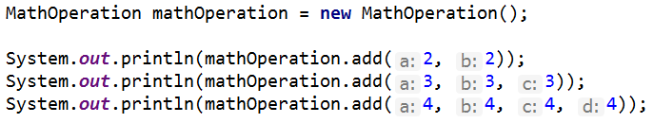
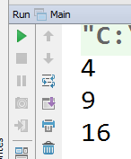
Problem: Overload Method
MathOperation
+add(int a, int b): int
+add(int a, int b, int c): int
+add(int a, int b, int c, int d): int
10
Notes:
(c) 2005 National Academy for Software Development - http://academy.devbg.org. All rights reserved. Unauthorized copying or re-distribution is strictly prohibited.(c) 2006 National Academy for Software Development - http://academy.devbg.org*
<number>##
Extensibility / Polymorphism: New functionality may be easily plugged in without changing existing classes as long the new plug-in classes extend given base classes.
Reusability: For a set of similar applications a framework can be defined using a core set of classes that are to be extended by classes that fill in the application-dependent part.
Information Hiding: If a more general class using a simpler contract is sufficient, details from extending classes may be hidden to some of the client classes. This allows them to be more independent from possible changes and diminishes the load of contracts that must be understood by a reader of these client classes.
*
07/16/96
(c) 2006 National Academy for Software Development - http://academy.devbg.org*
<number>##

Slide 13
Solution: Overload Method
public class MathOperation {
public int add(int a, int b) {
return a + b;
}
public int add(int a, int b, int c) {
return a + b + c;
}
public int add(int a, int b, int c, int d) {
return a + b + c + d;
}
}
10
Notes:
(c) 2005 National Academy for Software Development - http://academy.devbg.org. All rights reserved. Unauthorized copying or re-distribution is strictly prohibited.(c) 2006 National Academy for Software Development - http://academy.devbg.org*
<number>##
Extensibility / Polymorphism: New functionality may be easily plugged in without changing existing classes as long the new plug-in classes extend given base classes.
Reusability: For a set of similar applications a framework can be defined using a core set of classes that are to be extended by classes that fill in the application-dependent part.
Information Hiding: If a more general class using a simpler contract is sufficient, details from extending classes may be hidden to some of the client classes. This allows them to be more independent from possible changes and diminishes the load of contracts that must be understood by a reader of these client classes.
*
07/16/96
(c) 2006 National Academy for Software Development - http://academy.devbg.org*
<number>##

Slide 14
Rules for Overloading Method
Overloading can take place in the same class or in its sub-class
Constructor in Java can be overloaded
Overloaded methods must have a different argument list
Overloaded method should always be the part of the same class (can also take place in sub class), with same name but different parameters
They may have the same or different return types
10
Notes:
To pass more specific object to method
© Software University Foundation – http://softuni.org
This work is licensed under the Creative Commons Attribution-NonCommercial-ShareAlike license.
<number>

Slide 15
Runtime Polymorphism
Using of override method
public static void main(String[] args) {
Rectangle rect = new Rectangle(3.0, 4.0);
Rectangle square = new Square(4.0);
System.out.println(rect.area());
System.out.println(square.area());
}
Method overriding
14
Notes:
© Software University Foundation – http://softuni.org
This work is licensed under the Creative Commons Attribution-NonCommercial-ShareAlike license.
<number>

Slide 16
Runtime Polymorphism
Also known as Dynamic Polymorphism
public class Rectangle {
public Double area() {
return this.a * this.b;
}
}
public class Square extend Rectangle {
public Double area() { return this.a * this.a;
}
}
Method overriding
<number>
Notes:
Demo (look at View -> Notes Page)
© Software University Foundation – http://softuni.org
This work is licensed under the Creative Commons Attribution-NonCommercial-ShareAlike license.
<number>
public static void main(String[] args) {
Vegetarian babyDeer = new Deer();
Vegetarian babyElephant = new Elephant();
List<Vegetarian> vegetarianAnimals = new ArrayList<>();
vegetarianAnimals.add(babyDeer);
vegetarianAnimals.add(babyElephant);
}

Slide 17

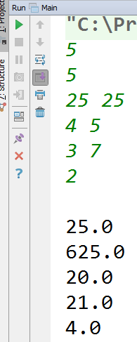
Problem: Override Method
Rectangle
-Double sideA
-Double sideB
+Double area()
Square
+Double area()
<number>
Notes:
(c) 2005 National Academy for Software Development - http://academy.devbg.org. All rights reserved. Unauthorized copying or re-distribution is strictly prohibited.(c) 2006 National Academy for Software Development - http://academy.devbg.org*
<number>##
Extensibility / Polymorphism: New functionality may be easily plugged in without changing existing classes as long the new plug-in classes extend given base classes.
Reusability: For a set of similar applications a framework can be defined using a core set of classes that are to be extended by classes that fill in the application-dependent part.
Information Hiding: If a more general class using a simpler contract is sufficient, details from extending classes may be hidden to some of the client classes. This allows them to be more independent from possible changes and diminishes the load of contracts that must be understood by a reader of these client classes.
*
07/16/96
(c) 2006 National Academy for Software Development - http://academy.devbg.org*
<number>##

Slide 18
Solution: Override Method
public class Square extends Rectangle {
private Double sideA;
public Square(Double side) {
super(side);
this.sideA = side;
}
public Double perimeter() { return this.sideA * 4; }
@Override
public Double area() {
return this.sideA * this.sideA;
}
}
<number>
Notes:
(c) 2005 National Academy for Software Development - http://academy.devbg.org. All rights reserved. Unauthorized copying or re-distribution is strictly prohibited.(c) 2006 National Academy for Software Development - http://academy.devbg.org*
<number>##
Extensibility / Polymorphism: New functionality may be easily plugged in without changing existing classes as long the new plug-in classes extend given base classes.
Reusability: For a set of similar applications a framework can be defined using a core set of classes that are to be extended by classes that fill in the application-dependent part.
Information Hiding: If a more general class using a simpler contract is sufficient, details from extending classes may be hidden to some of the client classes. This allows them to be more independent from possible changes and diminishes the load of contracts that must be understood by a reader of these client classes.
*
07/16/96
(c) 2006 National Academy for Software Development - http://academy.devbg.org*
<number>##

Slide 19
Rules for Overriding Method
Overriding can take place sub-class.
Argument list must be the same as that of the parent method
The overriding method must have same return type
Access modifier cannot be more restrictive
Private, static and final methods can NOT be overriden
The overriding method must not throw new or broader checked exceptions
<number>
Notes:
To pass more specific object to method
© Software University Foundation – http://softuni.org
This work is licensed under the Creative Commons Attribution-NonCommercial-ShareAlike license.
<number>

Slide 20

Polymorphism
Live Exercises in Class (Lab)
Notes:
<number>
© Software University Foundation – http://softuni.org
This work is licensed under the Creative Commons Attribution-NonCommercial-ShareAlike license.

Slide 21
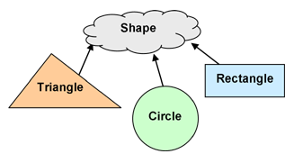
Abstract Classes
<number>
Notes:
© Software University Foundation – http://softuni.org
This work is licensed under the Creative Commons Attribution-NonCommercial-ShareAlike license.
<number>

Slide 22
Abstract Classes
Abstract class can NOT be instantiated
public abstract class Shape {}
public class Circle extends Shape {}
Shape shape = new Shape(); // Compile time error
Shape circle = new Circle(); // polymorphism
<number>

Slide 23
Abstract Classes
An abstract class may or may not include abstract methods
If it has at least one abstract method, it must be declared abstract
To use abstract class, you need to extend it
<number>

Slide 24
Abstract Classes Elements
Public abstract class Shape {
private Point startPoint;
protected Shape(Point startPoint) {
this.startPoint = startPoint;
}
public getStartPoint() { return this.startPoint; }
public abstract void draw();
}
Can have fields
Can have constructors
Can hold methods with code in them
Abstract methods MUST be overridden
<number>
Notes:
But they can be subclassed.
© Software University Foundation – http://softuni.org
This work is licensed under the Creative Commons Attribution-NonCommercial-ShareAlike license.
<number>

Slide 25
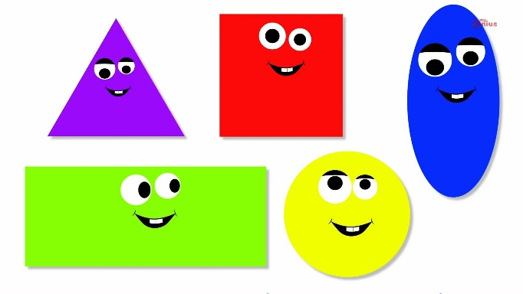
Problem: Shapes
Encapsulate area
Shape
-Double perimeter
-Double area
+getPerimeter()
#setPerimeter(Double area)
+calculatePerimeter
+calculateArea
Rectangle
Circle
-Double height
-Double width
-Double height
-Double width
+calculatePerimeter
+calculateArea
+calculatePerimeter
+calculateArea
<number>
Notes:
(c) 2005 National Academy for Software Development - http://academy.devbg.org. All rights reserved. Unauthorized copying or re-distribution is strictly prohibited.(c) 2006 National Academy for Software Development - http://academy.devbg.org*
<number>##
Extensibility / Polymorphism: New functionality may be easily plugged in without changing existing classes as long the new plug-in classes extend given base classes.
Reusability: For a set of similar applications a framework can be defined using a core set of classes that are to be extended by classes that fill in the application-dependent part.
Information Hiding: If a more general class using a simpler contract is sufficient, details from extending classes may be hidden to some of the client classes. This allows them to be more independent from possible changes and diminishes the load of contracts that must be understood by a reader of these client classes.
*
07/16/96
(c) 2006 National Academy for Software Development - http://academy.devbg.org*
<number>##

Slide 26
Solution: Shapes
public abstract class Shape {
private Double perimeter;
private Double area;
protected void setPerimeter(Double perimeter) {
this.perimeter = perimeter;
}
public Double getPerimeter() { return this.perimeter; }
protected void setArea(Double area) {this.area = area;}
public Double getArea() { return this.area; }
protected abstract void calculatePerimeter();
protected abstract void calculateArea();
}
<number>
Notes:
(c) 2005 National Academy for Software Development - http://academy.devbg.org. All rights reserved. Unauthorized copying or re-distribution is strictly prohibited.(c) 2006 National Academy for Software Development - http://academy.devbg.org*
<number>##
Extensibility / Polymorphism: New functionality may be easily plugged in without changing existing classes as long the new plug-in classes extend given base classes.
Reusability: For a set of similar applications a framework can be defined using a core set of classes that are to be extended by classes that fill in the application-dependent part.
Information Hiding: If a more general class using a simpler contract is sufficient, details from extending classes may be hidden to some of the client classes. This allows them to be more independent from possible changes and diminishes the load of contracts that must be understood by a reader of these client classes.
*
07/16/96
(c) 2006 National Academy for Software Development - http://academy.devbg.org*
<number>##

Slide 27
Solution: Shapes
public class Rectangle extends Shape {
//TODO: Add fields
public Rectangle(Double height, Double width) {
this.setHeight(height); this.setWidth(width);
this.calculatePerimeter(); this.calculateArea(); }
//TODO: Add getters and setters
@Override
protected void calculatePerimeter() {
setPerimeter(this.height * 2 + this.width * 2); }
@Override
protected void calculateArea() {
setArea(this.height * this.width); } }
<number>
Notes:
(c) 2005 National Academy for Software Development - http://academy.devbg.org. All rights reserved. Unauthorized copying or re-distribution is strictly prohibited.(c) 2006 National Academy for Software Development - http://academy.devbg.org*
<number>##
Extensibility / Polymorphism: New functionality may be easily plugged in without changing existing classes as long the new plug-in classes extend given base classes.
Reusability: For a set of similar applications a framework can be defined using a core set of classes that are to be extended by classes that fill in the application-dependent part.
Information Hiding: If a more general class using a simpler contract is sufficient, details from extending classes may be hidden to some of the client classes. This allows them to be more independent from possible changes and diminishes the load of contracts that must be understood by a reader of these client classes.
*
07/16/96
(c) 2006 National Academy for Software Development - http://academy.devbg.org*
<number>##

Slide 28
Solution: Shapes
public class Circle extends Shape{
private Double radius;
public Circle (Double radius) {
this.setRadius(radius);
this.calculatePerimeter();
this.calculateArea(); }
public final Double getRadius() {
return radius;
}
//TODO: Finish encapsulation
//TODO: Override calculate Area and Perimeter
}
<number>
Notes:
(c) 2005 National Academy for Software Development - http://academy.devbg.org. All rights reserved. Unauthorized copying or re-distribution is strictly prohibited.(c) 2006 National Academy for Software Development - http://academy.devbg.org*
<number>##
Extensibility / Polymorphism: New functionality may be easily plugged in without changing existing classes as long the new plug-in classes extend given base classes.
Reusability: For a set of similar applications a framework can be defined using a core set of classes that are to be extended by classes that fill in the application-dependent part.
Information Hiding: If a more general class using a simpler contract is sufficient, details from extending classes may be hidden to some of the client classes. This allows them to be more independent from possible changes and diminishes the load of contracts that must be understood by a reader of these client classes.
*
07/16/96
(c) 2006 National Academy for Software Development - http://academy.devbg.org*
<number>##

Slide 29
Summary
What is Polymorphism?
Types of Polymorphism
Static polymorphism
Dynamic polymorphism
Overload Methods
Override Methods
Abstract Classes
Abstract Methods
<number>
Notes:
*
(c) 2007 National Academy for Software Development - http://academy.devbg.org. All rights reserved. Unauthorized copying or re-distribution is strictly prohibited.*
<number>##

Slide 30












Java Advanced – Course Overview
https://softuni.bg/trainings/1976/java-oop-basics-june-2018#lesson-8737
Notes:
© Software University Foundation – http://softuni.org
This work is licensed under the Creative Commons Attribution-NonCommercial-ShareAlike license.
<number>

Slide 31





Trainings @ Software University (SoftUni)
Software University – High-Quality Education, Profession and Job for Software Developers
softuni.bg
Software University Foundation
http://softuni.foundation/
Software University @ Facebook
facebook.com/SoftwareUniversity
Software University Forums
forum.softuni.bg
Notes:
© Software University Foundation – http://softuni.org
This work is licensed under the Creative Commons Attribution-NonCommercial-ShareAlike license.
<number>

